Slide 1
Cascading Style Sheets
Media Queries

Slide 2
What is Media queries…..?
Media queries is used to apply CSS styles
To conditionally apply styles with the CSS @media and @import
To target specific media for the <style> , <source> , <link> .
And it is depending on device media type like desktop or tablet or mobile.
Characteristics are screen resolution , browser viewport width or height , transparency , orientation.

Slide 3
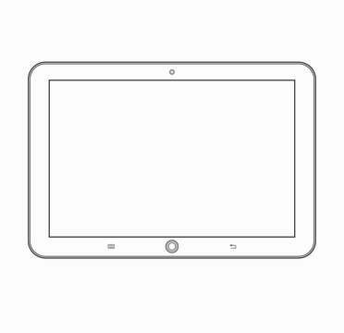
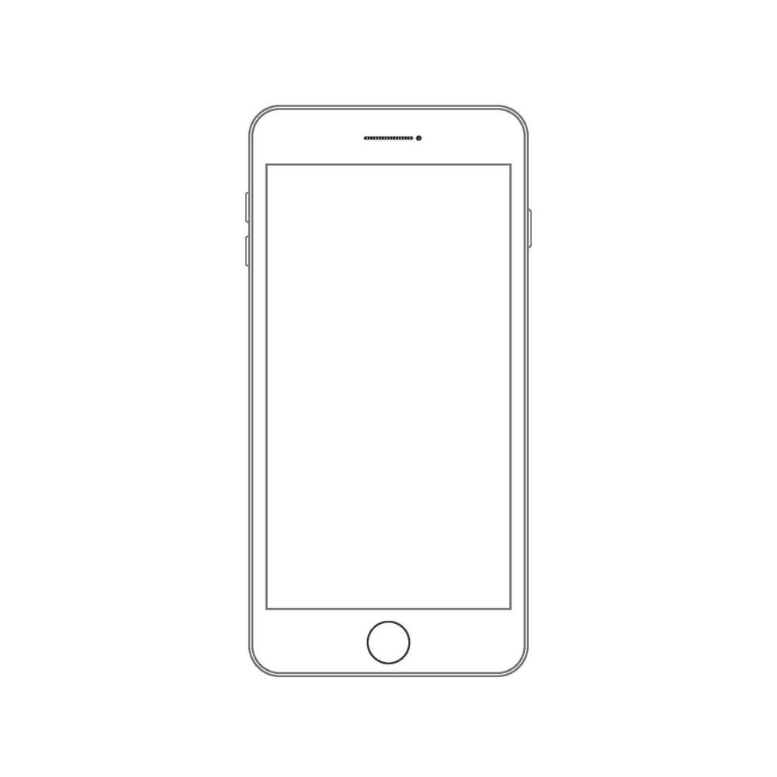
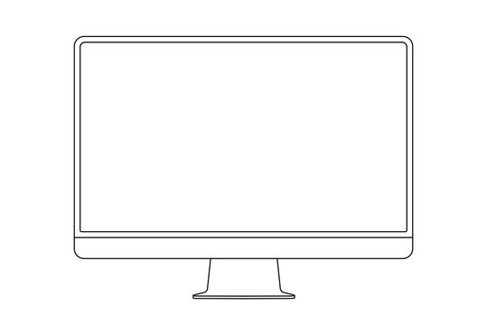
Media types
All - is used for all devices
Print - is used for print preview mode
Screen - is used for computers, mobiles,tablets.

Slide 4
Syntax
A media query is composed of an optional media type and any number of media feature expressions, which may optionally be combined in various ways using logical operators.
Media queries or case-insensitive.

Slide 5
Syntax example
<link rel="stylesheet" media="print" href="print.css">
<link rel="stylesheet" media="screen" href="screen.css">
<link rel="stylesheet" media="screen and (min-width: 480px)" href="example1.css">
<link rel="stylesheet" media="screen and (min-width: 701px) and (max-width: 900px)" href="example2.css"> etc....

Slide 6
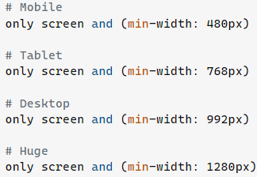
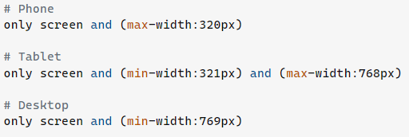
Some examples I found

